Slide 1
Integral calculus

Slide 2
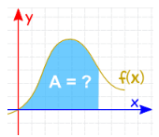
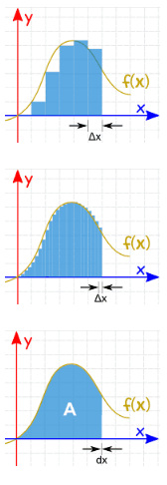
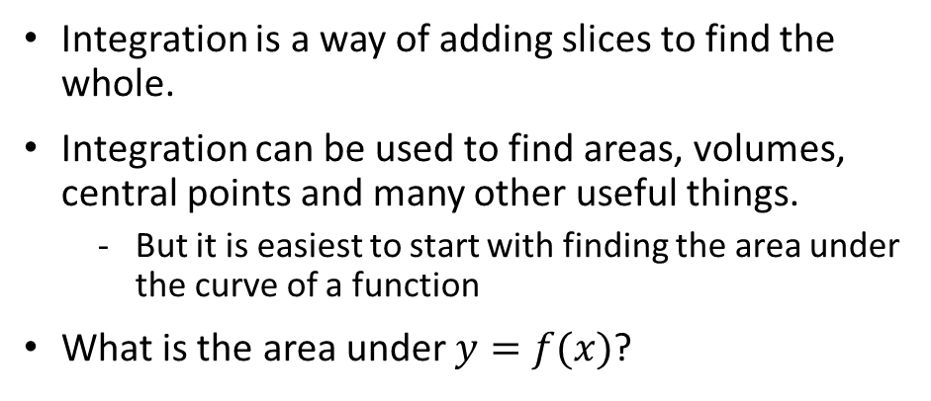
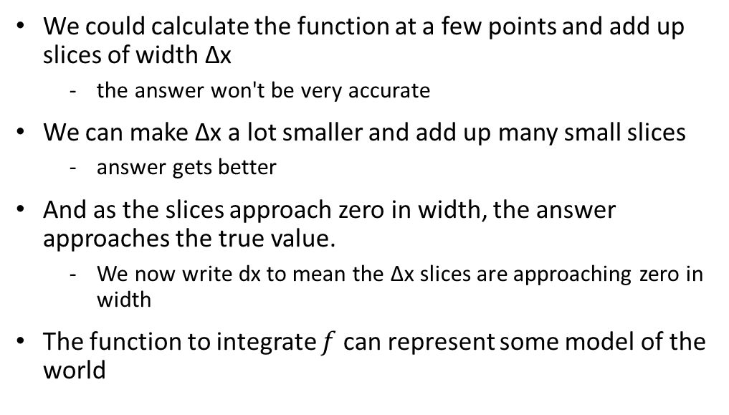
Introduction to integration
Integration is a way of adding slices to find the whole.
Integration can be used to find areas, volumes, central points and many other useful things.
But it is easiest to start with finding the area under the curve of a function
What is the area under $y=f(x)$?
We could calculate the function at a few points and add up slices of width Δx
the answer won't be very accurate
We can make Δx a lot smaller and add up many small slices
answer gets better
And as the slices approach zero in width, the answer approaches the true value.
We now write dx to mean the Δx slices are approaching zero in width
The function to integrate $f$ can represent some model of the world

Slide 3
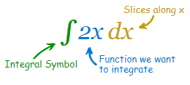
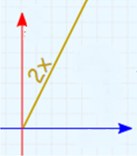
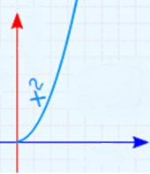

Integration basics
The notation of integrals refers to the concept of summing slices with slices approaching zero in width
the "Constant of Integration“ C is there because of all the functions whose derivative is 2x
Notes:
The symbol for "Integral" is a stylish "S“ (for "Sum", the idea of summing slices):
After the Integral Symbol we put the function we want to find the integral of (called the Integrand),
and then finish with dx to mean the slices go in the x direction (and approach zero in width).

Slide 4
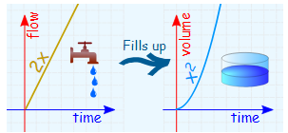
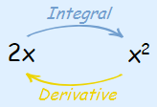
Integration example: tap and tank
Integration is like filling a tank from a tap.
The input (before integration) is the flow rate from the tap.
Integrating the flow (adding up all the little bits of water) gives us the volume of water in the tank.
As the flow rate increases, the tank fills up faster and faster.

Slide 5
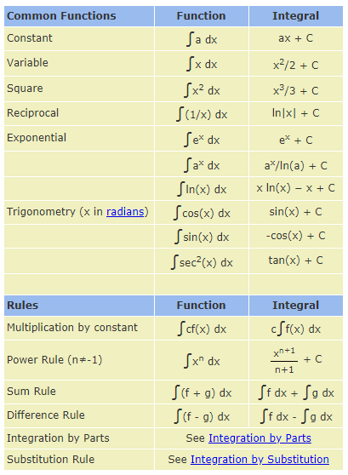
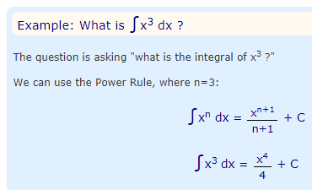
Integration rules for symbolic integration
There are 2 ways of integrating a function:
Symbolic
Numerical
The integral of many functions are well known, so symbolic integration is possible
There also useful rules to work out the integral of more complicated functions

Slide 6
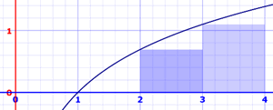
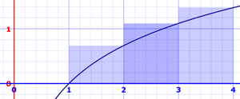
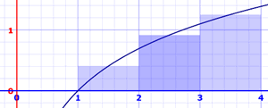
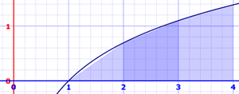
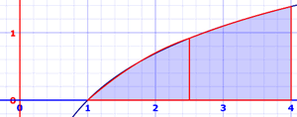
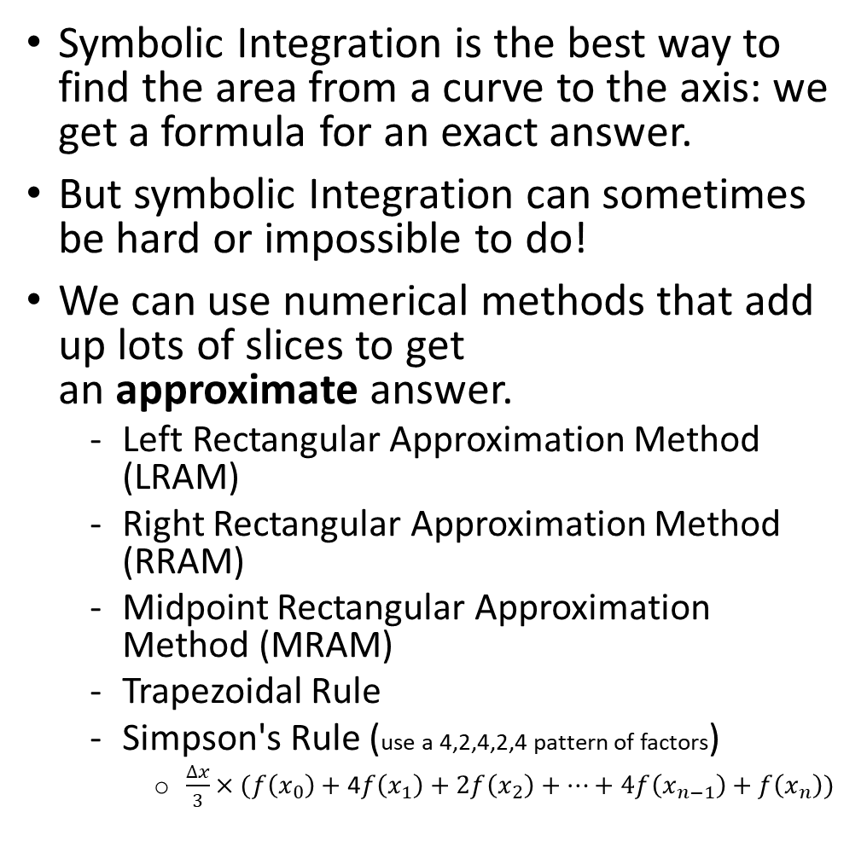
Numerical integration
Symbolic Integration is the best way to find the area from a curve to the axis: we get a formula for an exact answer.
But symbolic Integration can sometimes be hard or impossible to do!
We can use numerical methods that add up lots of slices to get an approximate answer.
Left Rectangular Approximation Method (LRAM)
Right Rectangular Approximation Method (RRAM)
Midpoint Rectangular Approximation Method (MRAM)
Trapezoidal Rule
Simpson's Rule (use a 4,2,4,2,4 pattern of factors)
$\frac{∆x}{3}×(f\left(x_{0}\right)+$ 4$f\left(x_{1}\right)+\text{2}f\left(x_{2}\right)+…+$ $4f\left(x_{n−1}\right)+$ $f\left(x_{n}\right))$
https://www.mathsisfun.com/calculus/integral-approximation-calculator.html

Slide 7
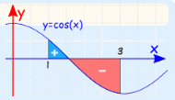
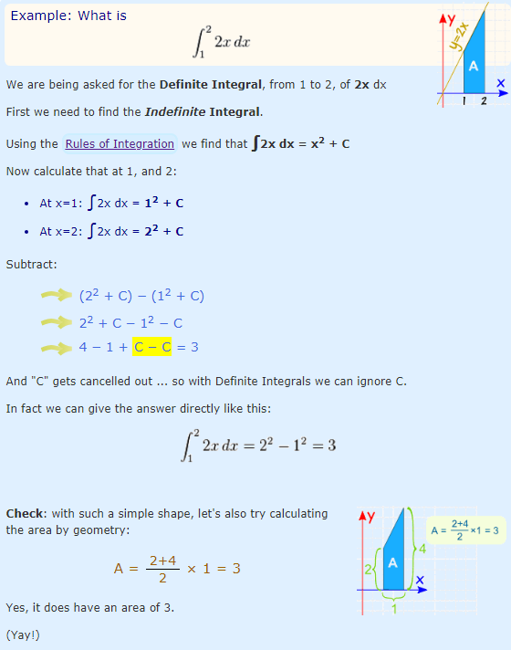
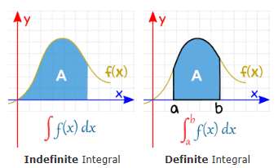
Definite versus indefinite integrals
A Definite Integral has actual values to calculate between
A Definite Integral has start and end values: in other words there is an interval [a, b]. (called limits, bounds or boundaries)
We find the Definite Integral using the evaluation theorem: calculate the Indefinite Integral at a, and b, then subtracting

Slide 8
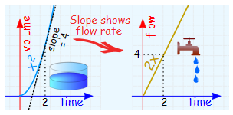
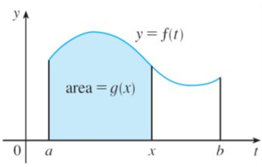


The fundamental theorem of calculus
Finding an Integral is the reverse of finding a Derivative (this concept has the fancy name of fundamental theorem of calculus)
If we differentiate the expression for the area we get the equation of the curve (the rate of change of the area)
The formula for the area is the anti-derivative of the equation of the current
If we integrate the expression of the curve, we get the equation for the area
So integration and differentiation are inverse processes of each other
$$g\left(x\right)=\int_{a}^{x}{f(t)}dt$$
$$\frac{d}{dx}g\left(x\right)=g^{′}\left(x\right)=f(t)$$

Slide 9
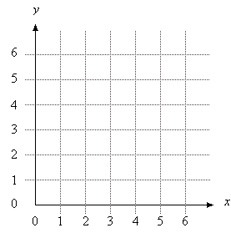
Calculus as an advanced type of multiplication and division
Multiplication makes addition easier. Instead of grinding through questions like
3 + 3 + 3 + 3 + 3
we can rewrite it as: 5 × 3
Or how much money do you make in a year if you make X NZD per week
But there's a big limitation: we must use identical, average-sized pieces.
What's 5 × 3? It's 5 copies of the same element.
The real world isn't so smooth. Calculus lets us accumulate (integrals) or separate (derivatives) shapes according to their actual, not average, amount:
Integrals are augmented multiplication that accumulates a sequence of steps (which could be of different sizes)
Derivatives are augmented division that splits a shape along a path (into possibly different-sized slices)
What's 20 / 5? It's 20 split into 4 equal parts.

Slide 10
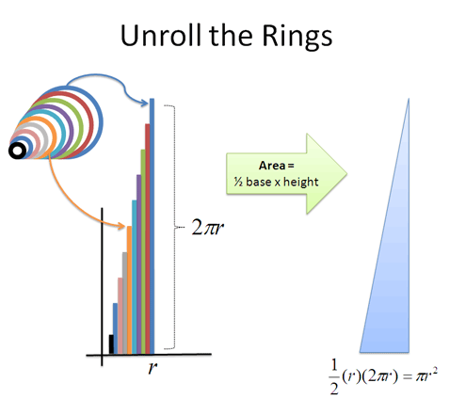
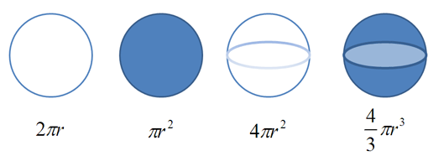
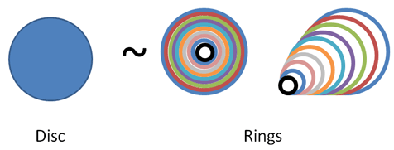
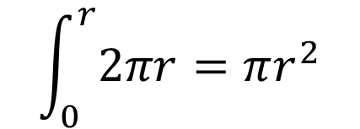

Intuition of integration
Suppose we know the equation for circumference ($2πr$) and want to figure out the equation for area
$$r$$
perimeter
area
shell surface
volume
realize that a disc is really just a bunch of rings put together. Similar to a tree trunk
$$\int_{0}^{r}{2πr=πr^{2}}$$

Slide 11
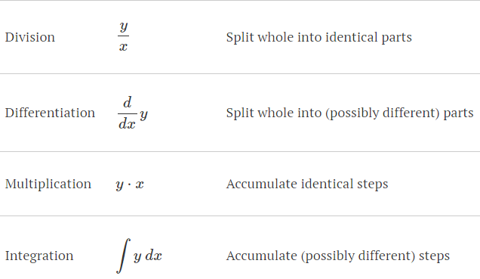
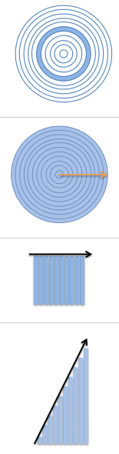



Calculus expands the concept of multiplication and division
Illustrative diagram
operation
notation
explanation
Example formula

Slide 12
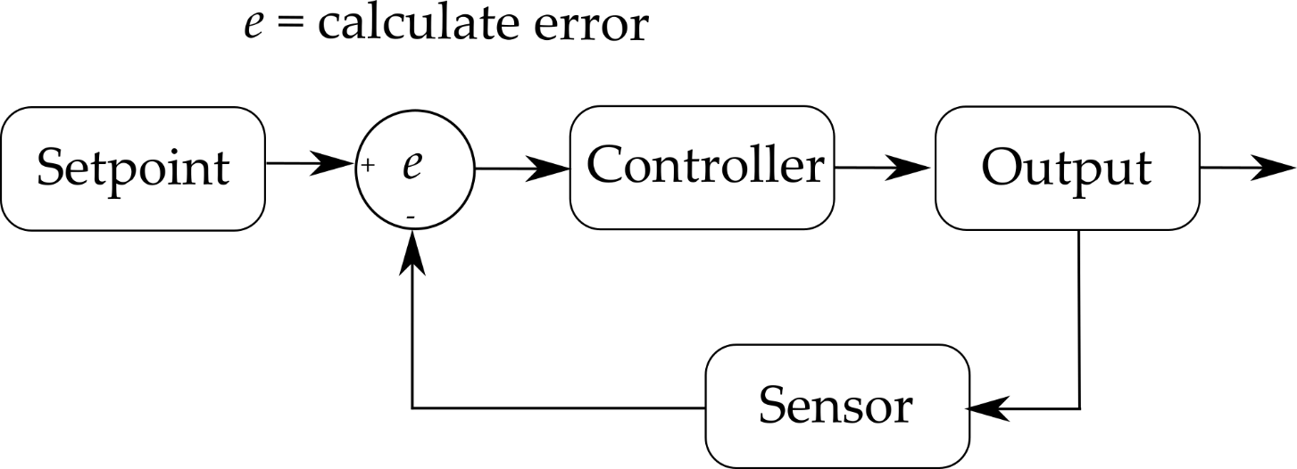
Control theory
Control theory in control systems engineering is a subfield of mathematics that deals with the control of continuously operating dynamical systems in engineered processes and machines.
A feedback controller is designed to generate an output that causes some corrective effort to be applied to a process so as to drive a measurable process variable towards a desired value known as the setpoint.
The controller uses an actuator to affect the process and a sensor to measure the results.
Notes:
In warm weather, a home thermostat is a familiar controller that attempts to correct temperature of the air inside a house. It measures the room temperature with a thermocouple and activates the air conditioner whenever an occupant lowers the desired room temperature or a random heat source raises the actual room temperature. In this example, the house is the process, the actual room temperature inside the house is the process variable, the desired room temperature is the setpoint, the thermocouple is the sensor, the activation signal to the air conditioner is the controller output, the air conditioner itself is the actuator, and the random heat sources (such as sunshine and warm bodies) constitute the loads on the process.

Slide 13
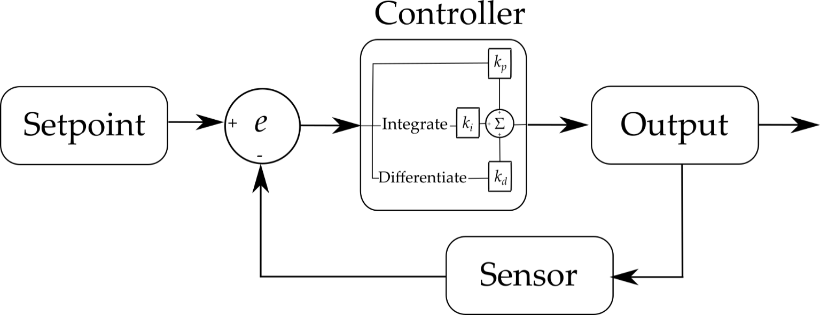
Proportional-Integral-Derivative (PID) control
Proportional-Integral-Derivative (PID) control is the most common control algorithm used in industry
PID describes a particular way of constructing your controller so it responds to changes in the error signal in a specific way
A PID (Proportional, Integral, Derivative) controller is a feedback system, stemming from control theory, that attempts to control a system or process. The PID controller calculates the error between a desired setpoint and a measured process variable. The controller continuously attempts to minimize this error over time by adjusting an output variable and recalculating the error.
It has been universally accepted as the standard algorithm for industrial control.
Notes:
A proportional-integral-derivative or PID controller performs much the same function as a thermostat but with a more elaborate algorithm for determining its output. It looks at the current value of the error, the integral of the error over a recent time interval, and the current derivative of the error signal to determine not only how much of a correction to apply, but for how long.

Slide 14
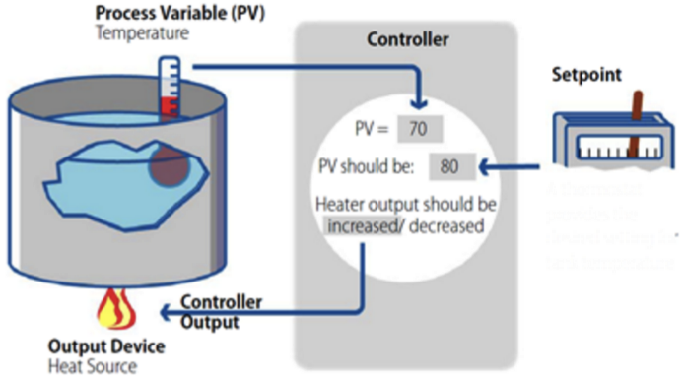
Example Applications
Temperature control
A PID can be used to continually measure and adjust temperature. The PID controller will measure the current temperature vs. the desired temperature and adjust the heat source in order to minimize the difference.
Automotives:
PID controllers are useful in the automotive industry for maintaining a constant speed or separation distance during cruise control. The controller will measure the actual distance compared to the desired distance and adjust the speed in order to minimize the delta.
Robotics
PID controllers can help a robot achieve a desired movement or position. The PID controller will measure how far off the course the robot is, and adjust the steering to remain on the course.

Slide 15
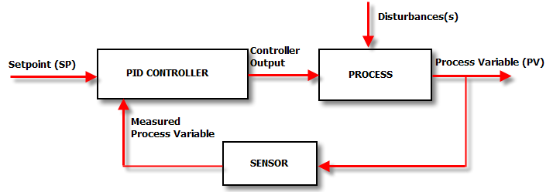
Anatomy of a feedback control system
The Setpoint (SP) is the value that we want the process to be.
For example, the temperature control system in our house may have a SP of 22°C.
This means that “we want the heating and cooling process in our house to achieve a steady temperature of as close to 22°C as possible”
The PID controller looks at the setpoint and compares it with the actual value of the Process Variable (PV) by means of the temperature sensor in the room and sees how close it is to 22°C.
If the SP and the PV are the same – then the controller doesn’t have to do anything, it will set its output to zero.
However, if there is a disparity between the SP and the PV we have an error and corrective action is needed. In our house this will either be cooling or heating depending on whether the PV is higher or lower than the SP respectively
Notes:
Let’s imagine the temperature PV in our house is higher than the SP. It is too hot. The air-con is switched on and the temperature drops.
The sensor picks up the lower temperature, feeds that back to the controller, the controller sees that the “temperature error” is not as great because the PV (temperature) has dropped and the air con is turned down a little.
This process is repeated until the house has cooled down to 22°C and there is no error.
Then a disturbance hits the system and the controller has to kick in again.
In our house the disturbance may be the sun beating down on the roof, raising the temperature of the air inside.
So that’s a really, really basic overview of a simple feedback control system.
Unfortunately, in the real world we need a controller that is a bit more complicated than the one described above, if we want top performance from our loops.

Slide 16
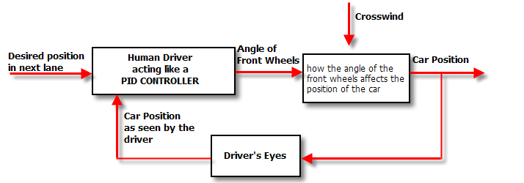
Understanding the controller
Unfortunately, in the real world we need a controller that is a bit more complicated than the one described above, if we want top performance from our loops.
To understand why, we will be doing some “thought experiments” where we are the controller.
We will be using the analogy of changing lanes on a freeway on a windy day. We are the driver, and therefore the controller of the process of changing the car’s position.
Notice how important closing the feedback loop is. If we removed the feedback loop we would be in “open loop control”, and would have to control the car’s position with our eyes closed!
Thankfully we are under “Closed loop control” -using our eyes for position feedback.
As we saw in the house-temperature example the controller takes the both the PV and SP signals, which it then puts through a black box to calculate a controller output. That controller output is sent to an actuator which moves to actually control the process

Slide 17
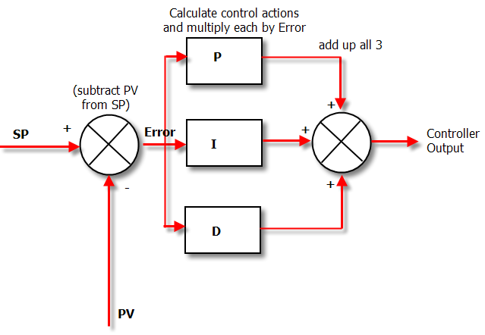

Under the hood of a PID controller
A PID controller applies 1, 2 or 3 calculations to the SP and Measured PV signals.
These calculations, called the “Modes of Control” include:
Proportional (P)
Integral (I)
Derivative (D)

Slide 18
Modes of control
The PV is subtracted from the SP to create the Error.
The error is simply multiplied by one, two or all of the calculated P, I and D actions (depending which ones are turned on).
Then the resulting “error x control actions” are added together and sent to the controller output.
These 3 modes are used in different combinations:
P – Sometimes used
PI - Most often used
PID – Sometimes used
PD – rare but can be useful for controlling servomotors.

Slide 19
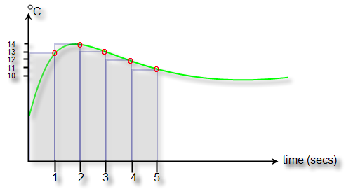
Recap of calculus concepts
Remember that derivative is just a mathematical term meaning rate of change
The integral of a signal is the sum of all the instantaneous values that the signal has been, from whenever you started counting until you stop counting.
So if you are to plot your signal on a trend and your signal is sampled every second, and let’s say you are measuring temperature. If you were to superimpose the integral of the signal over the first 5 seconds – it would look like this figure:
The green line is your temperature, the red circles are where your control system has sampled the temperature and the blue area is the integral of the temperature signal. It is the sum of the 5 temperature values over the time period that you are interested in. In numerical terms it is the sum of the areas of each of the blue rectangles:
(13 x 1)+(14x1)+(13x1)+(12x1)+(11x1) = 63 °C s
The curious units (degrees Celsius x seconds) are because we have to multiply a temperature by a time – but the units aren’t important
As you can probably remember from school –the integral turns out to be the area under the curve. When we have real world systems, we actually get an approximation to the area under the curve, which as you can see from the diagram gets better, the faster we sample.

Slide 20
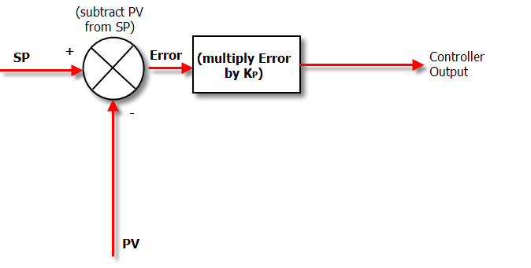
Proportional Controller
Here is a diagram of a controller where we only use P (proportional) control
In Proportional Only mode, the controller simply multiplies the Error by the Proportional Gain (Kp) to get the controller output.
The Proportional Gain is the setting that we tune to get our desired performance from a “P only” controller.

Slide 21
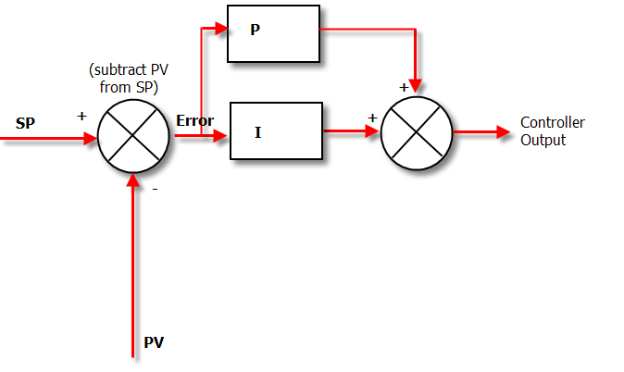
The P + I Controller
If we put Proportional and Integral Action together, we get the PI controller.
The Diagram below shows how the algorithm in a PI controller is calculated.
The tricky thing about Integral Action is that it will really screw up your process unless you know exactly how much Integral action to apply
Notes:
The way to adjust how much Integral Action you have is by adjusting a term called “minutes per repeat”. Not a very intuitive name is it?
So where does this strange name come from? It is a measure of how long it will take for the Integral Action to match the Proportional Action.
In other words, if the output of the proportional box on the diagram above is 20%, the repeat time is the time it will take for the output of the Integral box to get to 20% too.
And the important point to note is that the “bigger” integral action, the quicker it will get this 20% value. That is, it will take fewer minutes to get there, so the “minutes per repeat” value will be smaller.
In other words the smaller the “minutes per repeat” is the bigger the integral action.
To make things a bit more intuitive, a lot of controllers use an alternative unit of “repeats per minute” which is obviously the inverse of “minutes per repeat”.
The nice thing about “repeats per minute” is that the bigger it is - the bigger the resulting Integral action is.

Slide 22
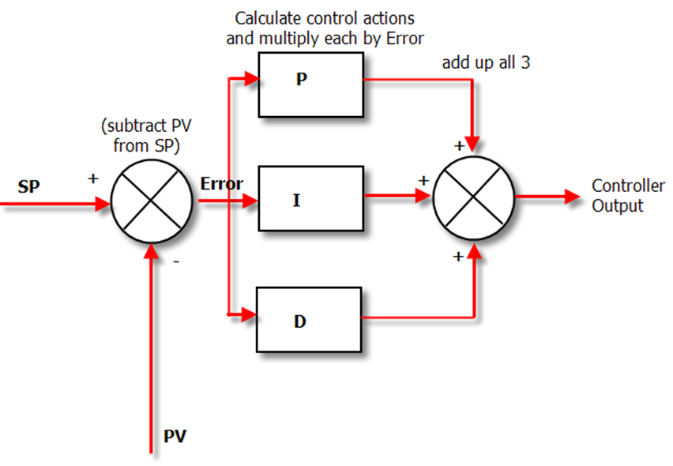
The PID Controller
Adding the Derivative control allows you to “predict” the future based on the current rate of change of the error signal
So adding derivative action can allow you to have bigger P and I gains and still keep the loop stable, giving you a faster response and better loop performance.

Slide 23
PID Equation
u(t) - Output
e(t) - Error Value
Kp - Proportional constant that accounts for the present error value. If the current error is large and positive, the output will be large and positive
Ki - Integral constant that accounts for historical error values. If the output is not strong, the error will accumulate, and the controller will respond by increasing the output.
Kd - Derivative constant that accounts for future error values. This term attempts to predict what the error will be in the future, and adjusts accordingly.

Slide 24
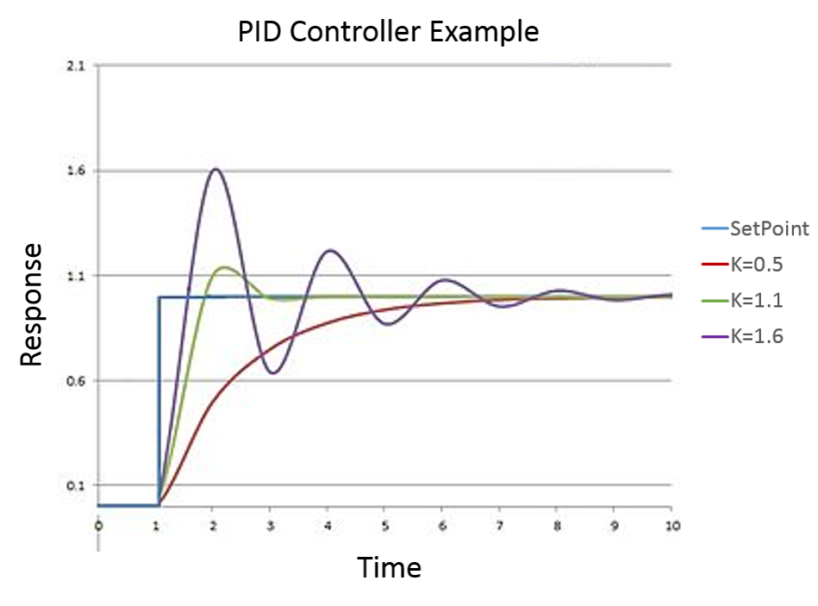
Tuning a PID
Tuning a PID (i.e., setting the P,I, and D tuning constants appropriately) can be tricky
The idea is to weight the sum of the proportional, integral, and derivative terms so as to produce a controller output that steadily drives the process variable in the direction required to eliminate the error.
The graph shows a PIS response graph on how the response of PID controller can change based on the set coefficients.
In this example, the system is subjected to a setpoint change (blue curve).
The red controller with K = 0.5 reacts rather slowly and reaches the setpoint with no overshoot.
This condition is referred to as overdamped.
The purple controller with K = 1.6 reacts extremely fast and severely overshoots the setpoint. The controller adjusts accordingly so that the output eventually settles down at the setpoint.
This condition is referred to as underdamped.
Finally, the green controller with K = 1.1 reaches the setpoint quickly with minimal overshoot.
Each PID controller application is different than the next and the coefficients need to be adjusted appropriately to achieve the desired response.

Slide 25
Application issues (optional)
How to best tune a PID controller depends upon how the process responds to the controller’s corrective efforts. Processes that react instantly and predictably don’t really require feedback at all. A car’s headlights, for example, come on as soon as the driver hits the switch. No subsequent corrections are required to achieve the desired illumination.
On the other hand, the car’s cruise controller cannot accelerate the car to the desired cruising speed so quickly. Because of friction and the car’s inertia, there is always a delay between the time that the cruise controller activates the accelerator and the time that the car’s speed reaches the setpoint. A PID controller must be tuned to account for such lags .
Consider a sluggish process with a relatively long lag—an overloaded car with an undersized engine, for example. Such a process tends to respond slowly to the controller’s efforts. If the process variable should suddenly begin to differ from the setpoint, the controller’s immediate reaction will be determined primarily by the actions of the derivative term in the PID equation. This will cause the controller to initiate a burst of corrective efforts the instant the error changes from zero. A cruise controller with derivative action would kick in when the car encounters an uphill climb and suddenly begins to slow down. The change in speed would also initiate the proportional action that keeps the controller’s output going until the error is eliminated. After a while, the integral term will also begin to contribute to the controller’s output as the error accumulates over time. In fact, the integral action will eventually come to dominate the output signal since the error decreases so slowly in a sluggish process. Even after the error has been eliminated, the controller will continue to generate an output based on the history of errors that have been accumulating in the controller’s integrator. The process variable may then overshoot the setpoint, causing an error in the opposite direction.
If the integral tuning constant is not too large, this subsequent error will be smaller than the original, and the integral action will begin to diminish as negative errors are added to the history of positive ones. This whole operation may then repeat several times until both the error and the accumulated error are eliminated. Meanwhile, the derivative term will continue to add its share to the controller output based on the derivative of the oscillating error signal. The proportional action, too, will come and go as the error waxes and wanes.
Now suppose the process has very little lag so that it responds quickly to the controller’s efforts. The integral term in the PID equation will not play as dominant a role in the controller’s output since the errors will be so short lived. On the other hand, the derivative action will tend to be larger since the error changes rapidly in the absence of long lags.
Clearly, the relative importance of each term in the controller’s output depends on the behavior of the controlled process. Determining the best mix suitable for a particular application is the essence of controller tuning.
For the sluggish process, a large value for the derivative tuning constant D might be advisable to accelerate the controller’s reaction to an error that appears suddenly. For the fast-acting process, however, an equally large value for D might cause the controller’s output to fluctuate wildly as every change in the error (including extraneous changes caused by measurement noise) is amplified by the controller’s derivative action.

Slide 26
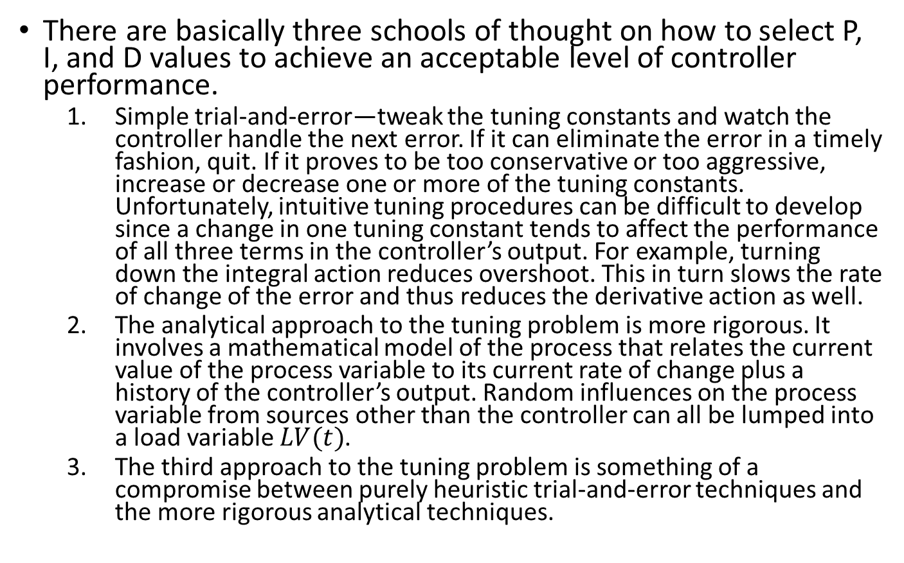
Tuning techniques (optional)
There are basically three schools of thought on how to select P, I, and D values to achieve an acceptable level of controller performance.
Simple trial-and-error—tweak the tuning constants and watch the controller handle the next error. If it can eliminate the error in a timely fashion, quit. If it proves to be too conservative or too aggressive, increase or decrease one or more of the tuning constants. Unfortunately, intuitive tuning procedures can be difficult to develop since a change in one tuning constant tends to affect the performance of all three terms in the controller’s output. For example, turning down the integral action reduces overshoot. This in turn slows the rate of change of the error and thus reduces the derivative action as well.
The analytical approach to the tuning problem is more rigorous. It involves a mathematical model of the process that relates the current value of the process variable to its current rate of change plus a history of the controller’s output. Random influences on the process variable from sources other than the controller can all be lumped into a load variable $LV(t)$.
The third approach to the tuning problem is something of a compromise between purely heuristic trial-and-error techniques and the more rigorous analytical techniques.

